Slide 1
CMU 10-742 Machine Learning in Healthcare
Lecture 4: Regulation
Adam Berger

Slide 2
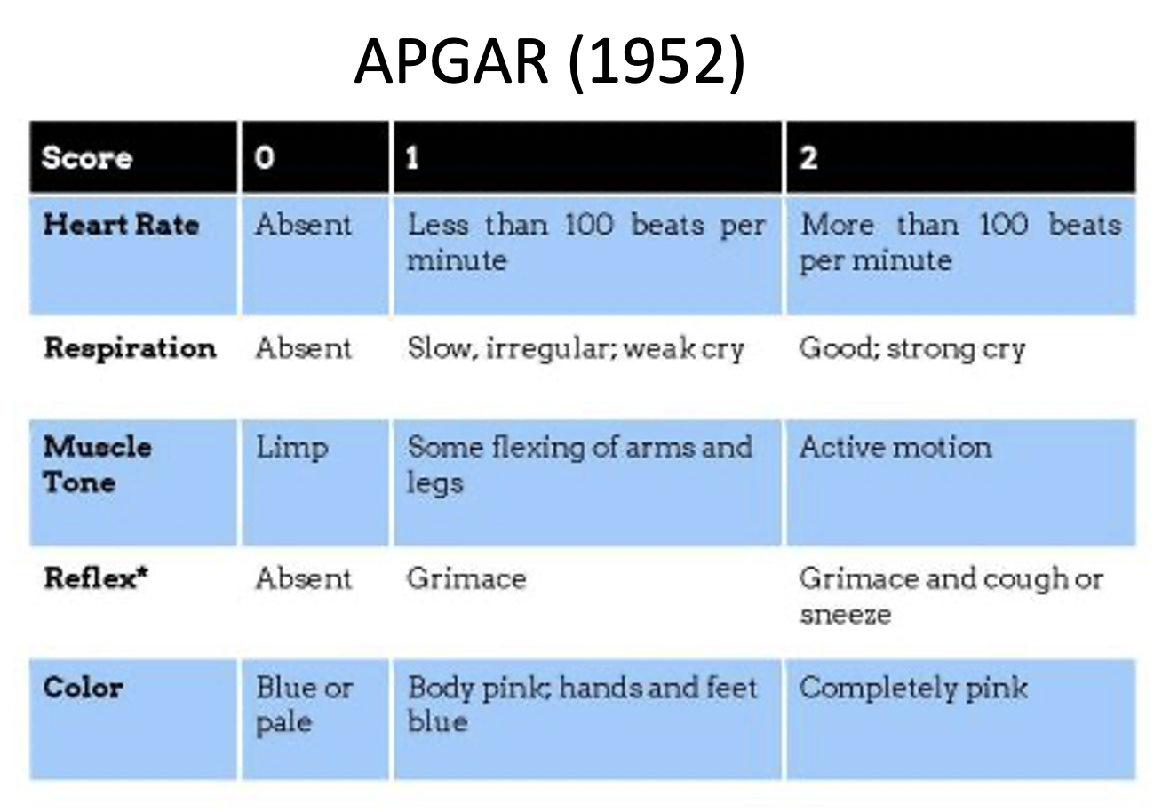
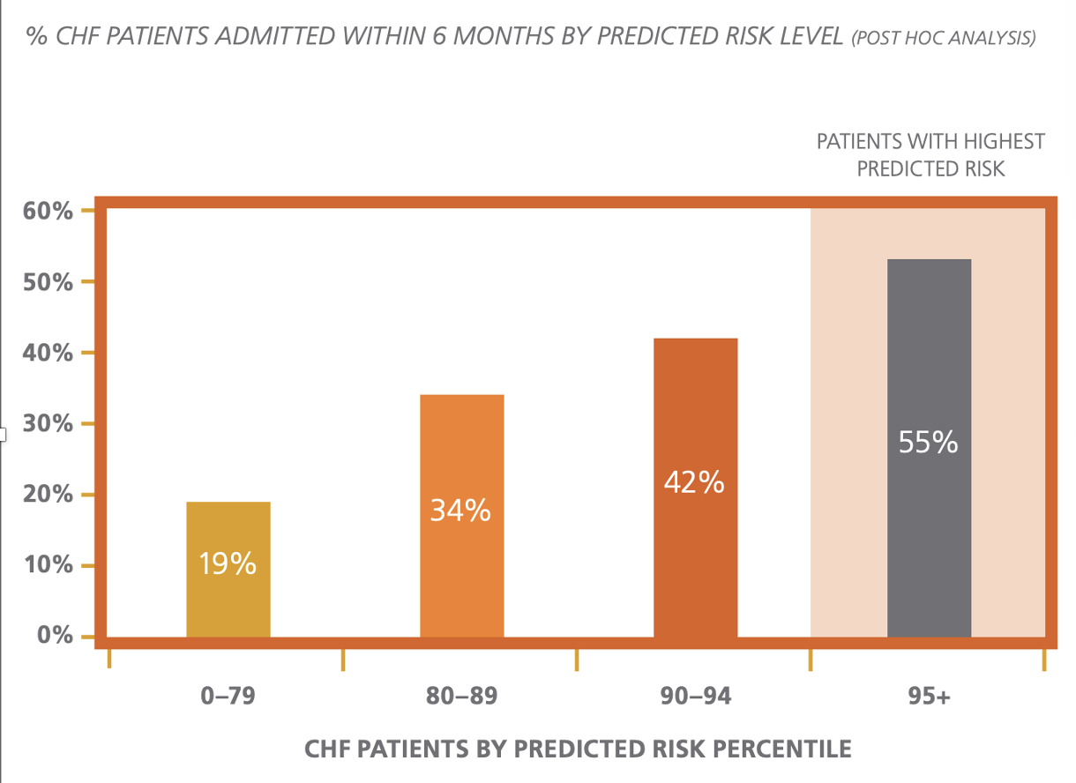
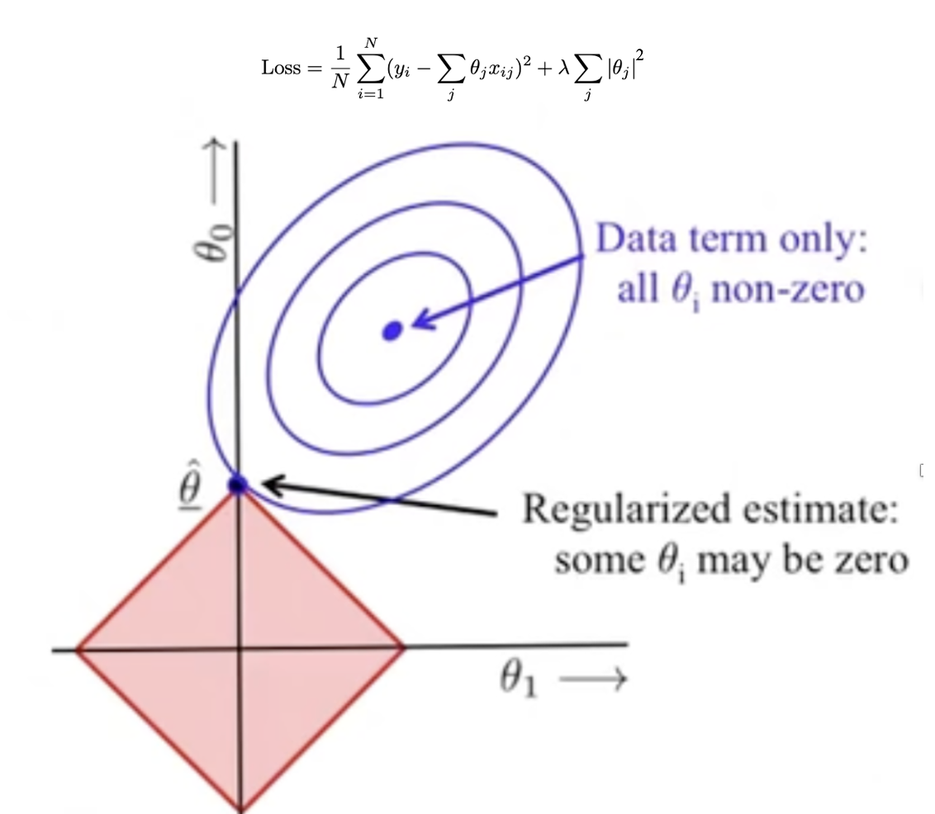
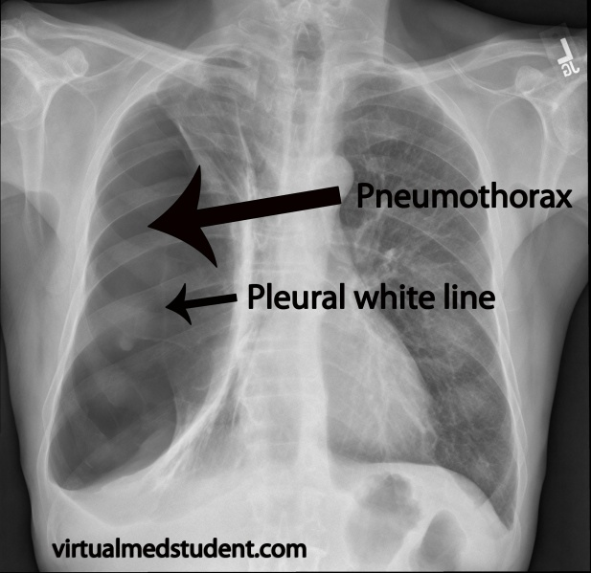
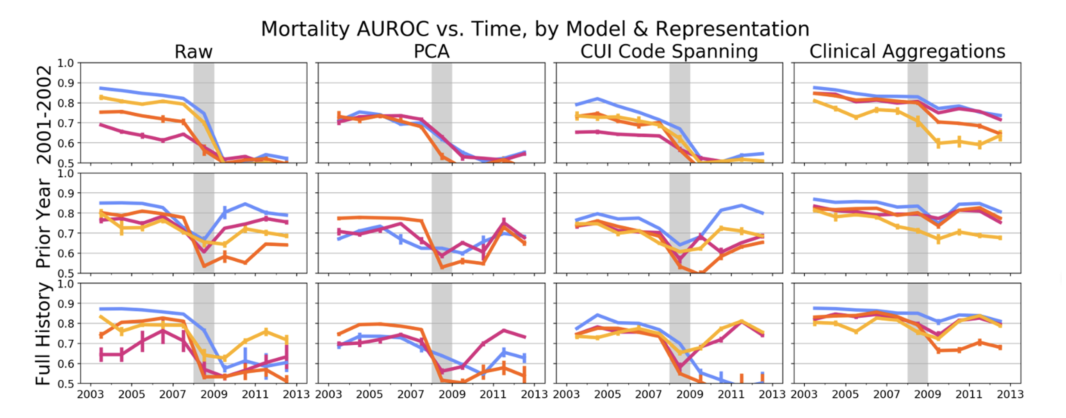
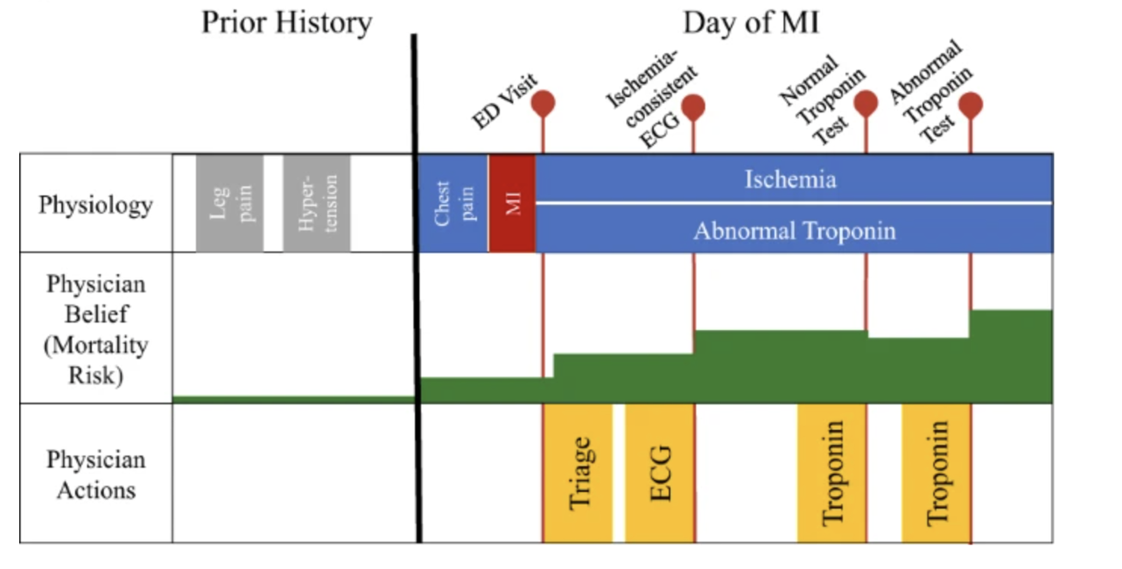
Lecture 3 Recap: Risk Stratification

Slide 3
Course Logistics
Assignment 0 is DUE today
Assignment 1 is DUE next Thurs (Sep 12)
Final Project Milestone 1 DUE on Oct 10

Slide 4
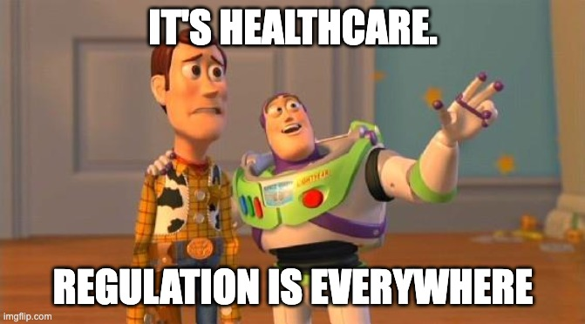
Notes:
This lecture is heavy on policy and legislation. Not a traditional CS lecture. Why should we spend time on this?
Legislation drives financial incentives.
Example: ACA in 2010 – financial penalties for hospitals with high readmission rates. ML to predict readmission. Already showed the Optum one on Tuesday.
Example: CURES Act in 2016 led to Cancer Moonshot - encouraged adaptive trial design for clinical trials. Which we’ll talk about later in lecture 21

Slide 5
Today
A brief history of healthcare in U.S.
Privacy & HIPAA
De-ID
Open Data
HITECH Act
CURES Act

Slide 6
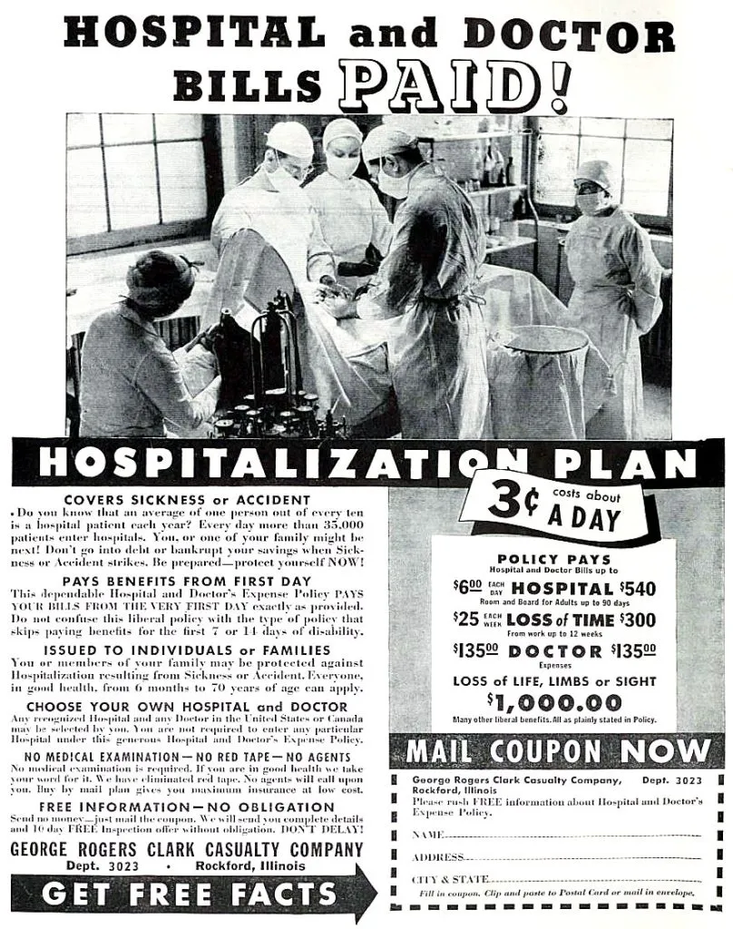
Notes:
Before ~1900, no need for insurance -- no healthcare to buy! Hospitals were where you went to die. No expensive imaging, surgeries, therapies.
People just paid cash, no problem.
Then: purely commercial insurance. “Commercial” = gov’t not involved. A.ka. “private”

Slide 7
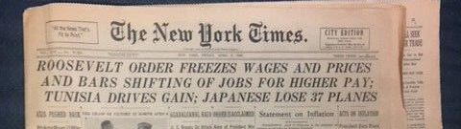
Employer-Based Health Insurance
Labor shortage during WW2
Businesses raise wages to attract workers
Inflation
FDR freezes wages
To attract workers, employers start offering health insurance (which was tax-exempt)
Notes:
Today, most people get health insurance through their employer or through the gov’t. How did we get here?

Slide 8
Pre-1965
Employer insurance is great, but what about old/unemployed people?
1963: >40% of Americans 65+ lack health insurance.

Slide 9
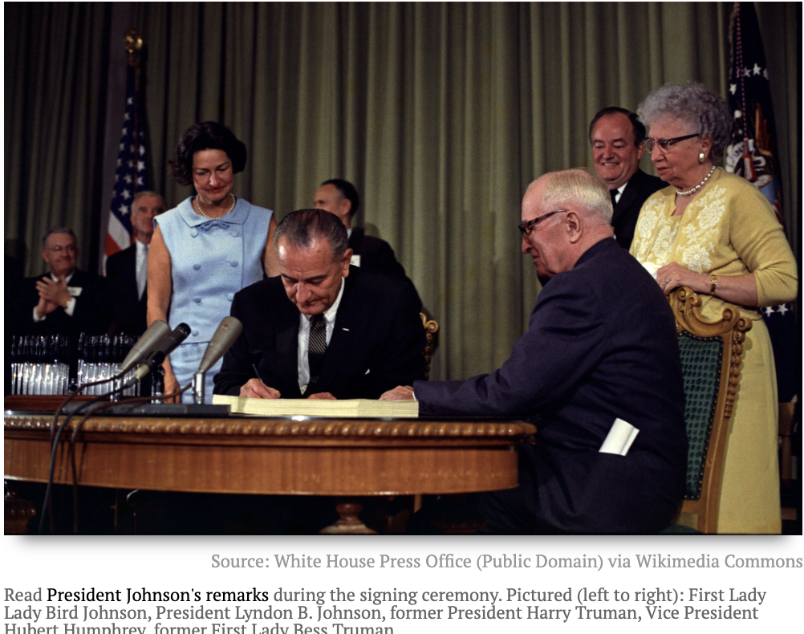
Medicare/Medicaid
Who was the very first Medicare enrollee?

Slide 10
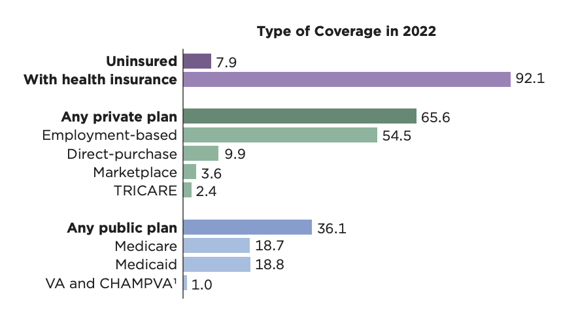
Insurance Today: Public/Private Hybrid
https://www.census.gov/content/dam/Census/library/publications/2023/demo/p60-281.pdf
Notes:
CMS has the plurality of insurance members. (more than any other entity). Gives CMS tons of leverage

Slide 11
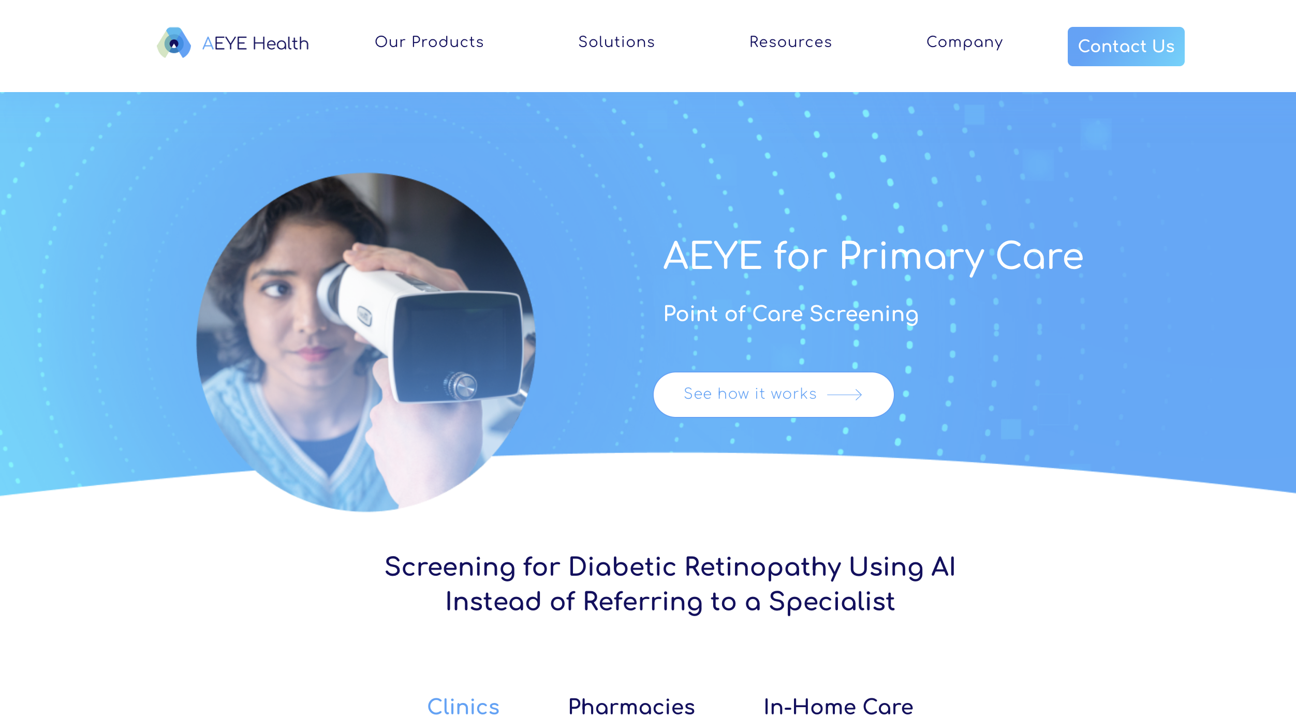
CMS Can Drive (or Inhibit) Innovation
CPT Code | Description
92229 | Retinal imaging with AI
75580 | Heart CT scan with AI analysis
https://www.aeyehealth.com/primary-care
Notes:
CMS decides what to pay for – creates opp’y
“Follow the money”
Right: a company building a business off this CPT code -- 92229.
Code means PCPs can test for DR in their office and get paid for it, vs. referring to specialist.

Slide 12
Today
A brief history of healthcare in U.S.
Privacy & HIPAA
De-ID
Open Data
HITECH Act
CURES Act

Slide 13

Privacy rule
HIPAA 1996 Legislation

Slide 14



Important HIPAA roles
Covered Entity (CE)
Business Associate (BA)
Notes:
CE: delivers or pays for care
BA: works on behalf of CE and handles PHI
Quiz:
What is CVS?
Apple Health?
A company that does an annual audit of a health plan.
A janitor who cleans a doctors office?
Shredding companies that dispose of physical documents containing PHI?
CE obligations > BA obligations (e.g. NOPP)

Slide 15
HIPAA Privacy Rule
”Protected health information" (PHI): any information held by a covered entity that concerns health status, provision of healthcare, or payment for healthcare that can be linked to an individual.
A covered entity must obtain written authorization from individuals for any use or disclosure of PHI that is not for treatment, payment, or healthcare operations (TPO).

Slide 16
Which of these are PHI?
A recorded conversation between a doctor and patient
A birth date without any other identifying information
A patient's credit card information used for billing
A list of appointment times without patient names
An x-ray of an elbow with a patient's name on it
The same x-ray without the patient’s name on it
Notes:
Which are not PHI?
1 yes
2 no
3 yes
4 no
5 yes
6 maybe –exif info? MRN? Unique condition?

Slide 17
HIPAA privacy rule:
…must obtain written authorization from individuals for any use or disclosure of PHI that is not for treatment, payment, or healthcare operations (TPO) purposes.
Notes:
How could I ever use patient data in ML research?
Not covered by the “TPO exception”

Slide 18

Notes:
There’s actually two approaches, we’ll dsicuss both

Slide 19
Solution 1: IRB
Review, approve, monitor research involving human subjects.
Ensure that the research is conducted ethically and that the rights and welfare of the participants are protected.
Required for most research projects involving human subjects in the U.S. States, esp. federally-funded research.
Notes:
You’re learning about this in pset 0

Slide 20
When is IRB approval required ?
Study is research (“contributes to general knowledge”) AND involves human subjects
(also some other conditions we’re not going into here)

Slide 21
Which Require IRB Approval?
Interviewing people about their political views
A study that observes public behavior in a park or other public space.
A study using patient notes written by a clinician
Teacher evaluating a new teaching method in their classroom, to publish the results.
Notes:
They all do –(1) involves human subjects, (2) aims to contribute to generalizable knowledge,

Slide 22
Which Require IRB Approval?
Hospital collects patient feedback on a new type of waiting room, to decide whether to use this design in their new hospital.
Teacher evaluating a new teaching method in their classroom, to decide whether to adopt this method next year.
Notes:
No
1 and 2 are not meant to contribute to general knowledge.

Slide 23
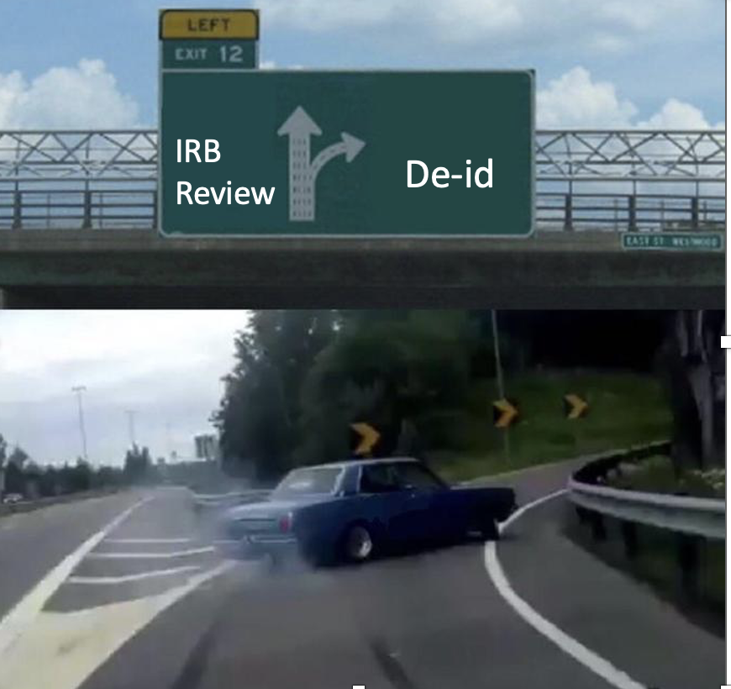
Solution 2: De-ID
IRB Review
De-id
Notes:
Live human subjects always requires IRB
But retrospective analysis using PHI -> can IRB *or* de-identify

Slide 24
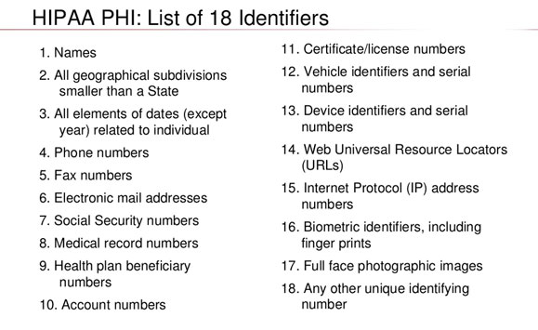
HIPAA de-identification: typical approach
“Safe Harbor”
Remove exactly these fields:
Notes:
(expert determination is the other, less common approach)

Slide 25
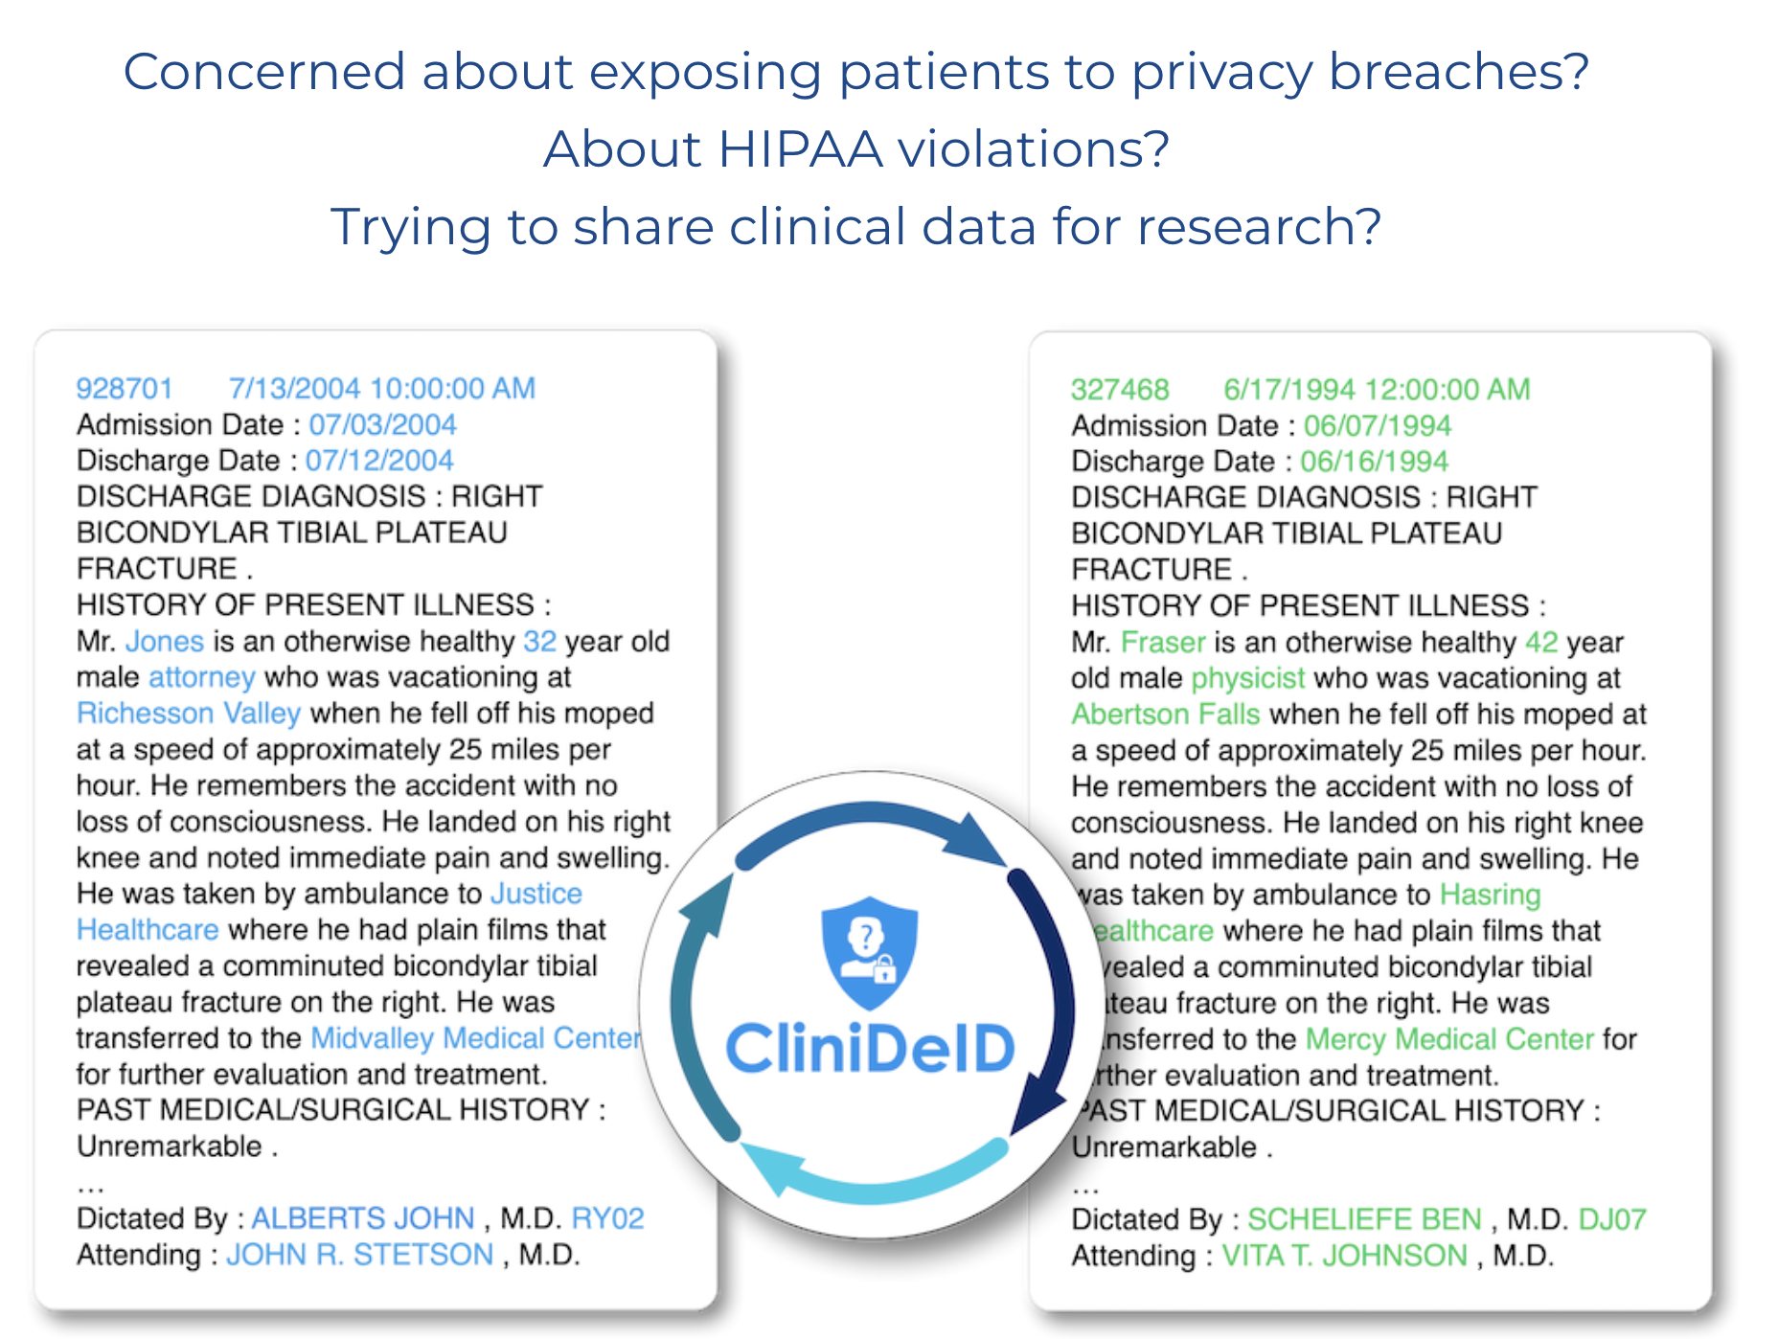
https://clinacuity.com/clinideid/
Notes:
You can build or buy products to do this. Here’s an actual de-id product. Pretty typical.
Left = original
Right = transformed
What transformations do you see here?
Change dates (why?)
Change facility name (why?)
Provider name is changed – not strictly necessary under safe harbor (unless provider panel is small)

Slide 26
De-Identification is “AI-Complete”
The 35-year-old female CEO of a local tech startup presented with chest pain.
Notes:
That example makes de-id look easy,
Here's an example that makes de-id look really difficult.

Slide 27
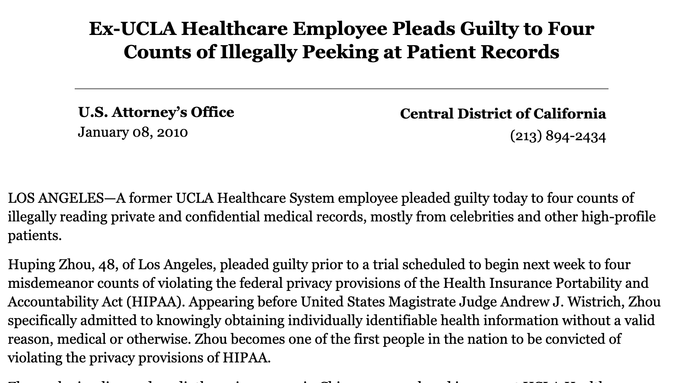
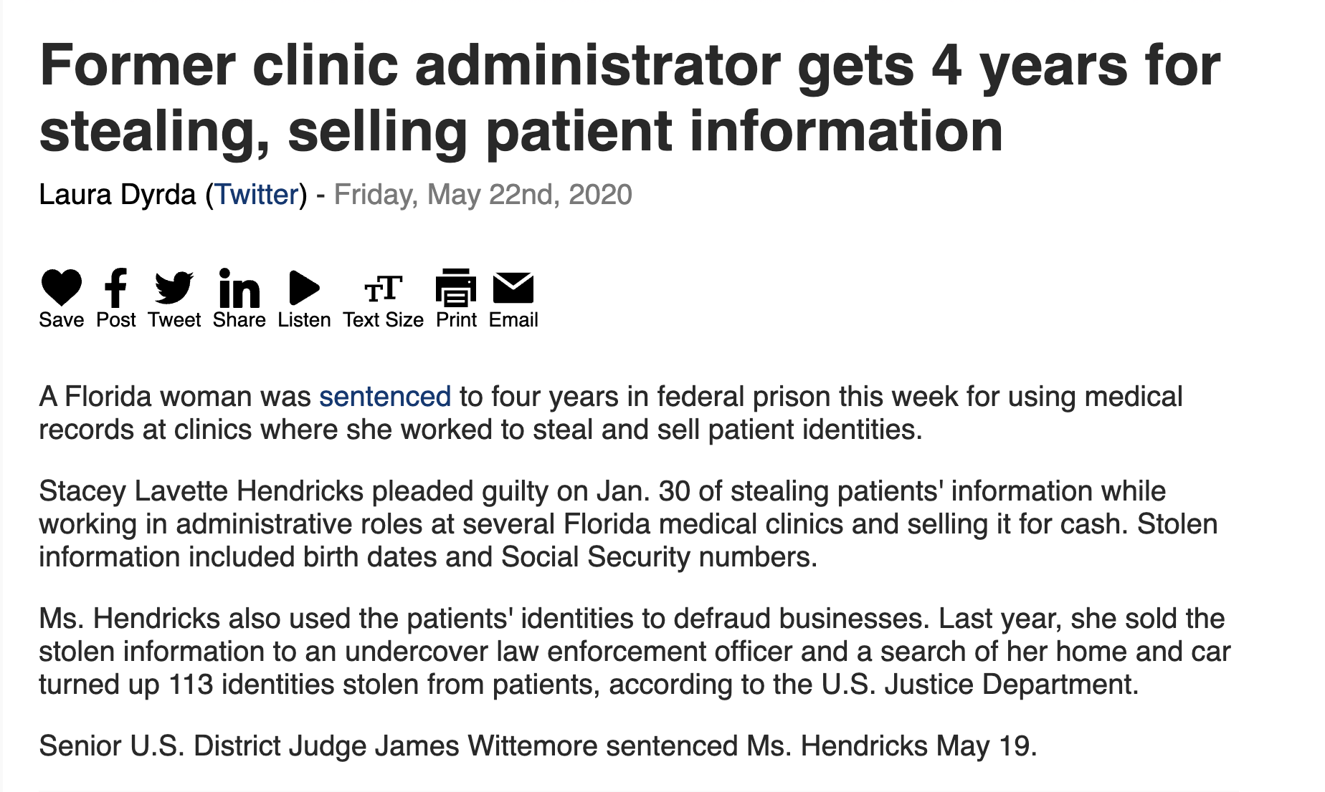
HIPAA Has Teeth

Slide 28
Today
A brief history of healthcare in U.S.
Privacy & HIPAA
De-ID
Open Data
HITECH Act
CURES Act
Notes:
How might we perform De-ID using ML

Slide 29
How Might We Apply (Supervised) ML?
Date: 05/15/2023
Patient: John Doe
DOB: 09/22/1980
MRN: 123456789
Dr. Sarah Johnson saw Mr. Doe today for follow-up of hypertension. Patient reports compliance with lisinopril 10mg daily. BP today 138/88. Patient works as a teacher at Springfield High School and reports increased stress lately. Recommended lifestyle modifications and scheduled follow-up in 3 months. Contact number: (555) 123-4567.
Plan:
1. Continue lisinopril 10mg daily
2. Follow up with Dr. Johnson on 08/15/2023
3. Labs ordered: Basic metabolic panel
Dictated by: Dr. Sarah Johnson
NPI: 1234567890
Date: <DATE>
Patient: <PATIENT_NAME>
DOB: <DATE_OF_BIRTH>
MRN: <MEDICAL_RECORD_NUMBER>
Dr. <PHYSICIAN_NAME> saw <PATIENT_NAME> today for follow-up of hypertension. Patient reports compliance with lisinopril 10mg daily. BP today 138/88. Patient works as a teacher at <LOCATION> and reports increased stress lately. Recommended lifestyle modifications and scheduled follow-up in 3 months. Contact number: <PHONE_NUMBER>.
Plan:
1. Continue lisinopril 10mg daily
2. Follow up with Dr. <PHYSICIAN_NAME> on <DATE>
3. Labs ordered: Basic metabolic panel
Dictated by: Dr. <PHYSICIAN_NAME>
NPI: <NATIONAL_PROVIDER_IDENTIFIER>
INPUT Original note
OUTPUT: 18 fields removed

Slide 30
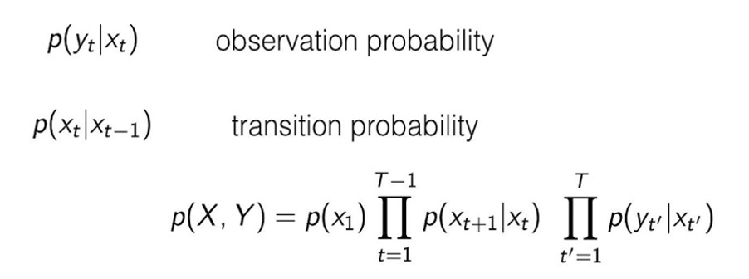
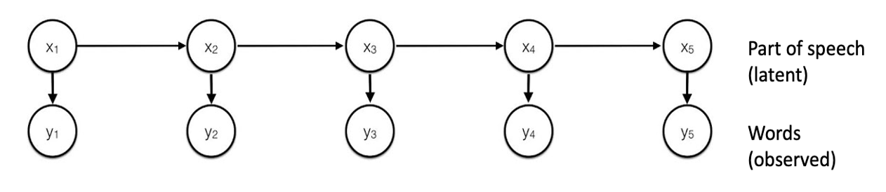
article noun verb preposition article
The elephant looked at the
Notes:
Sorta looks like a part of speech tagging problem, which people tend to use HMMs for
Can use (Baum Welch, EM) to learn the model params
Can use Viterbi for inference – find optimal POS tags

Slide 31
Could this work for De-Id?
P(‘Quackenbush’ | NAME)
[pass] NAME [pass] [pass] [pass]
De-id label
(latent)
Professor Quackenbush taught the class
Notes:
No.
pdf for p(y|x) assigns no prob mass to most names as they are OOV
Can’t use features like “this token is in a known list of doctors or hospitals or last names”
Can’t use features like “first letter is capitalized” or “previous word was Mr.” or “next word is a common last name”
Names, dates, orgs are often multi-token, HMM has no way of capturing this.

Slide 32
A “sibling” problem: Named Entity Recognition
Breakthrough in Renewable Energy Research
Scientists at the Karpov Institute of Physical Chemistry in Moscow have made a significant breakthrough in the field of renewable energy. Dr. Yelena Volkova and her team have developed a new type of perovskite solar cell that achieves an unprecedented 35% efficiency rate.
The research, published in the journal Angewandte Chemie, was funded by a grant from the Skolkovo Foundation. Dr. Volkova's collaborator, Prof. Hiroshi Yamamoto from Tohoku University, called the discovery "a game-changer for sustainable energy production."
The team used a novel compound, methylammonium lead triiodide, combined with a layer of graphene oxide to create the high-efficiency cells. The process was aided by the Lomonosov supercomputer at Moscow State University.
Breakthrough in [FIELD] Research
Scientists at the [ORGANIZATION] in [LOCATION] have made a significant breakthrough in the field of [FIELD]. [PERSON] and her team have developed a new type of [TECHNOLOGY] that achieves an unprecedented [PERCENTAGE] efficiency rate.
The research, published in the [PUBLICATION], was funded by a grant from the [ORGANIZATION]. [PERSON]'s collaborator, [PERSON_TITLE Prof.] [PERSON] from [ORGANIZATION], called the discovery "a game-changer for sustainable energy production."
The team used a novel compound, [CHEMICAL], combined with a layer of [MATERIAL] to create the high-efficiency cells. The process was aided by the [TECHNOLOGY] at [ORGANIZATION].

Slide 33
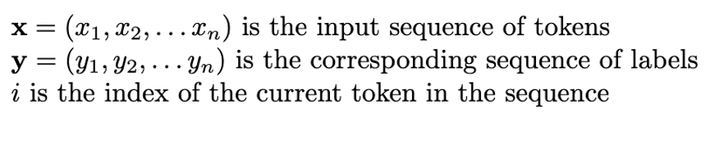
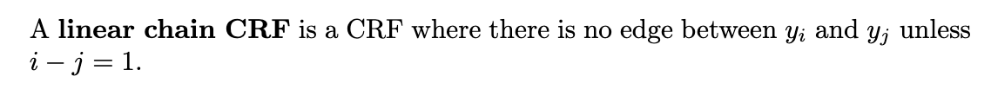
Conditional Random Fields (CRF)
[pass] [pass] [ORGANIZATION]
y₁
y₂
y₃
labels
x₁
x₂
x₃
words
Scientists at Karpov
https://www.youtube.com/watch?v=rI3DQS0P2fk and https://pages.cs.wisc.edu/~jerryzhu/cs769/CRF.pdf
Notes:
A little old school now (BERT models have overtaken them).
Discriminative model p(y|x) – don’t care how x is generated, don't need to model x. (Great b/c X can contain all sorts of unknown tokens!)
Terminology: Confusingly, it’s standard to use y for hidden labels and x for observed for CRFs
Linear chain CRF

Slide 34
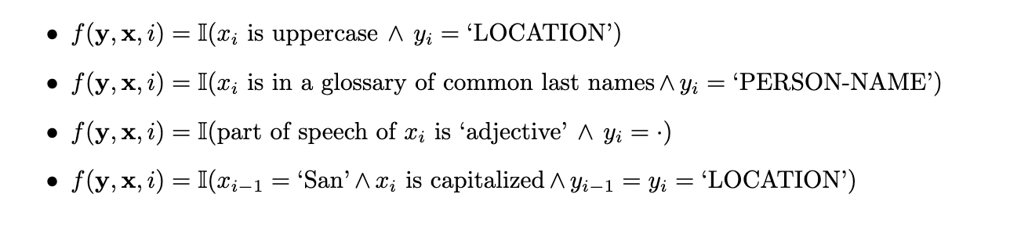
Feature Functions
Notes:
I = indicator function
Common feature functions for NER CRF

Slide 35
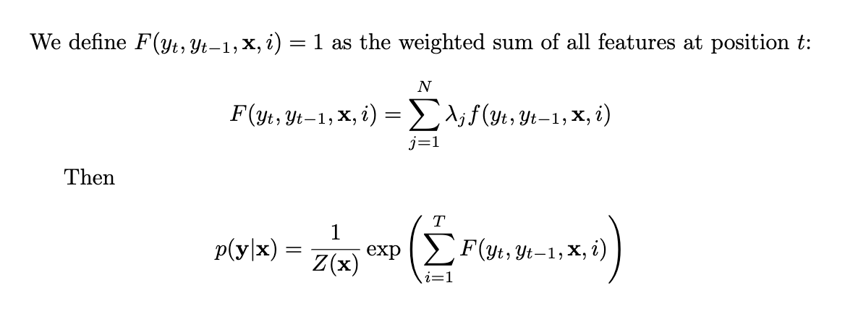
Weighted sum over all N features in model
Sum over all T positions in sentence
Notes:
Compute model params lambdas by gradient descent
Inference: calculate Y_star = argmax p(Y|x) by Viterbi algorithm (since it’s a linear chain CRF)

Slide 36
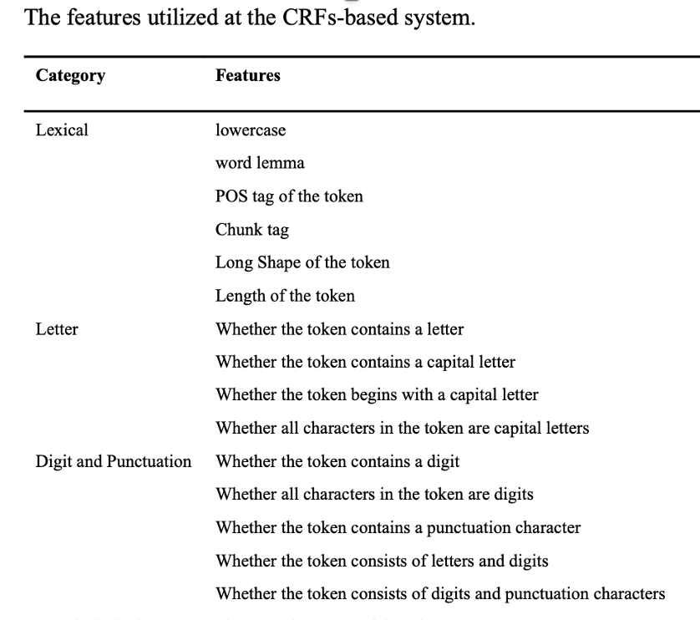
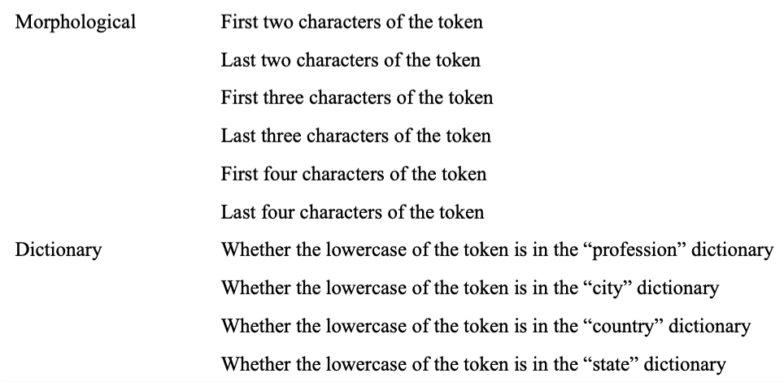
CRF for De-Identification
https://www.ncbi.nlm.nih.gov/pmc/articles/PMC5890009/pdf/nihms914230.pdf
Notes:
actual list of feature types for a paper on CRFs for NER

Slide 37
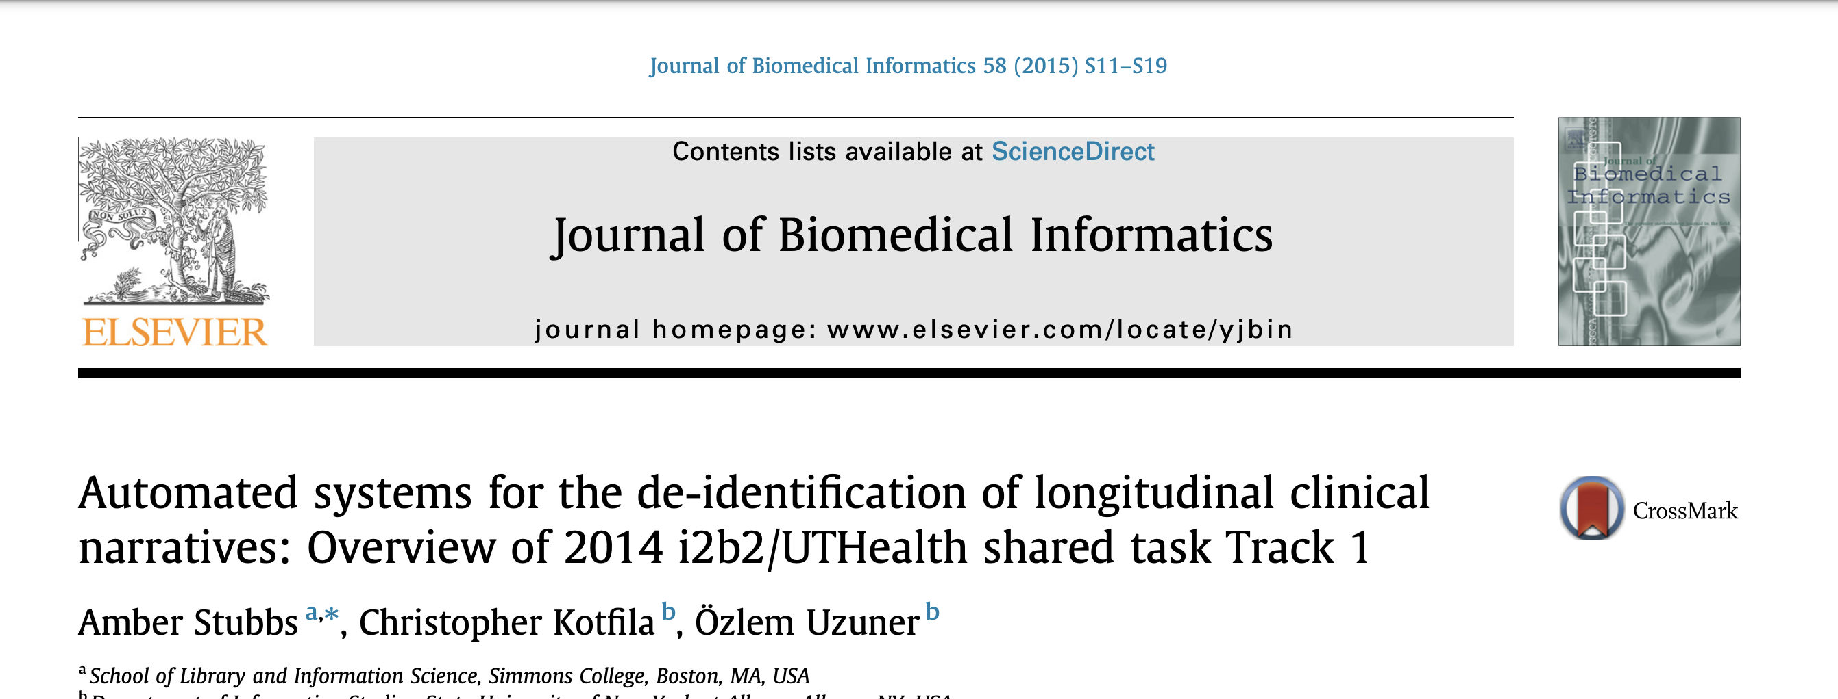
Evaluating a De-Id Model
https://www.sciencedirect.com/science/article/pii/S1532046415001173
Notes:
2014 contest in informatics – de-identification of medical records
They discuss different kinds of failures for a dei-id model.
Q: What do you think is the most dangerous kid of failure? (False pos or false negative?)
A: False negative! (bias towards high recall – dial it up – conservative model)

Slide 38
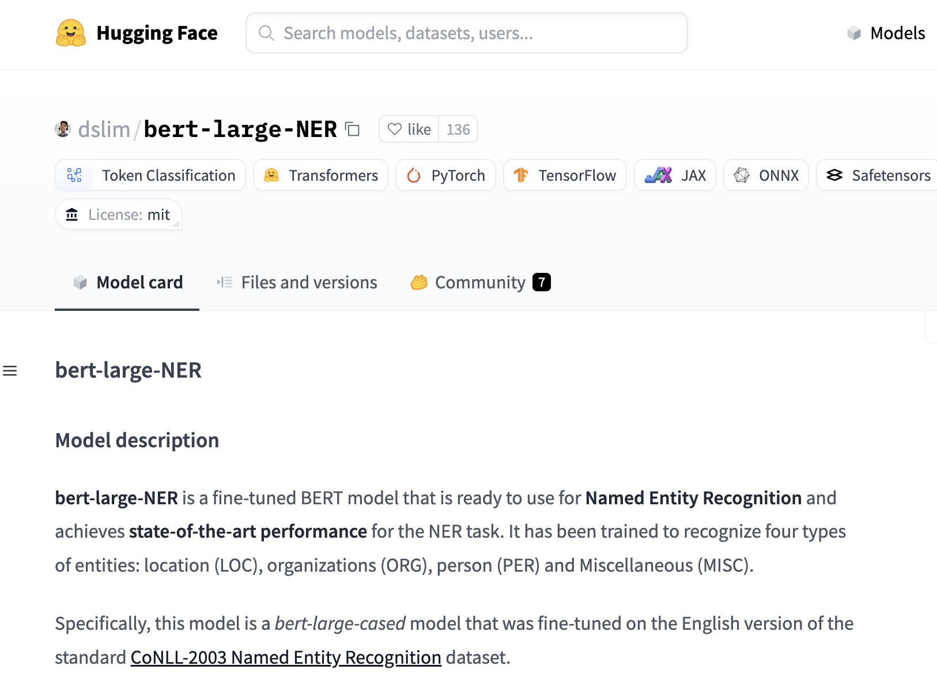
Notes:
Trained model
(not in healthcare)

Slide 39
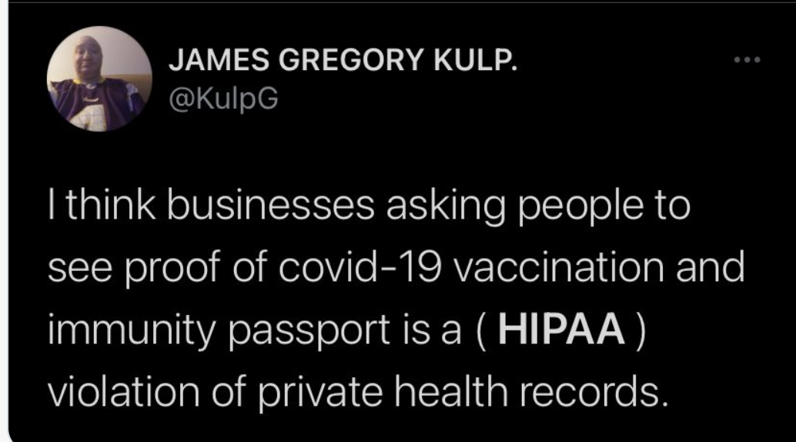
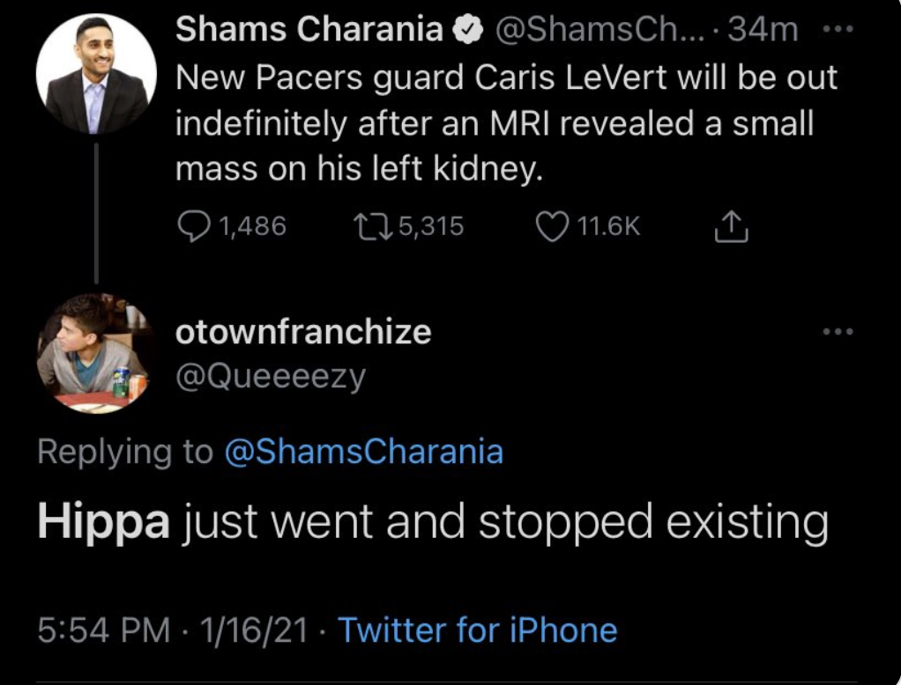
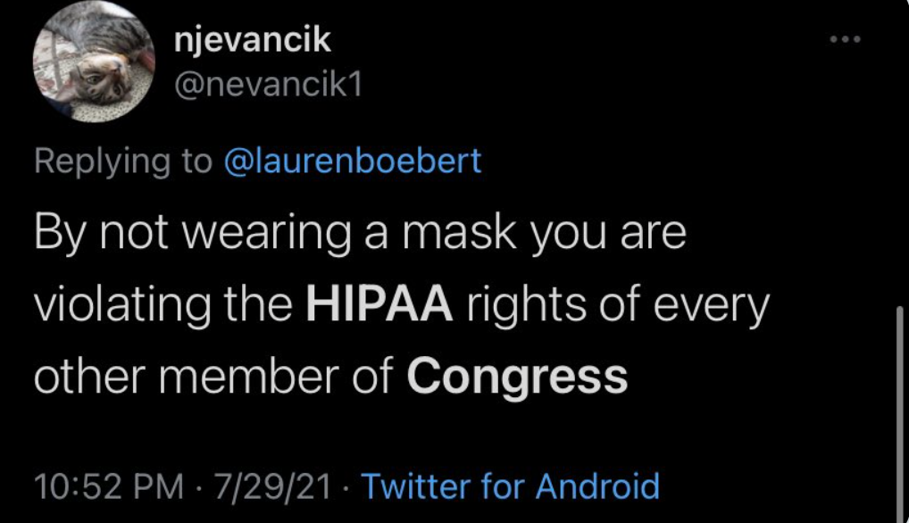
HALFTIME
Notes:
“bad hipaa takes”
HIPAA only applies to CEs/BAAs!

Slide 40
Today
A brief history of healthcare in U.S.
Privacy & HIPAA
De-ID
Open Data
HITECH Act
CURES Act

Slide 41
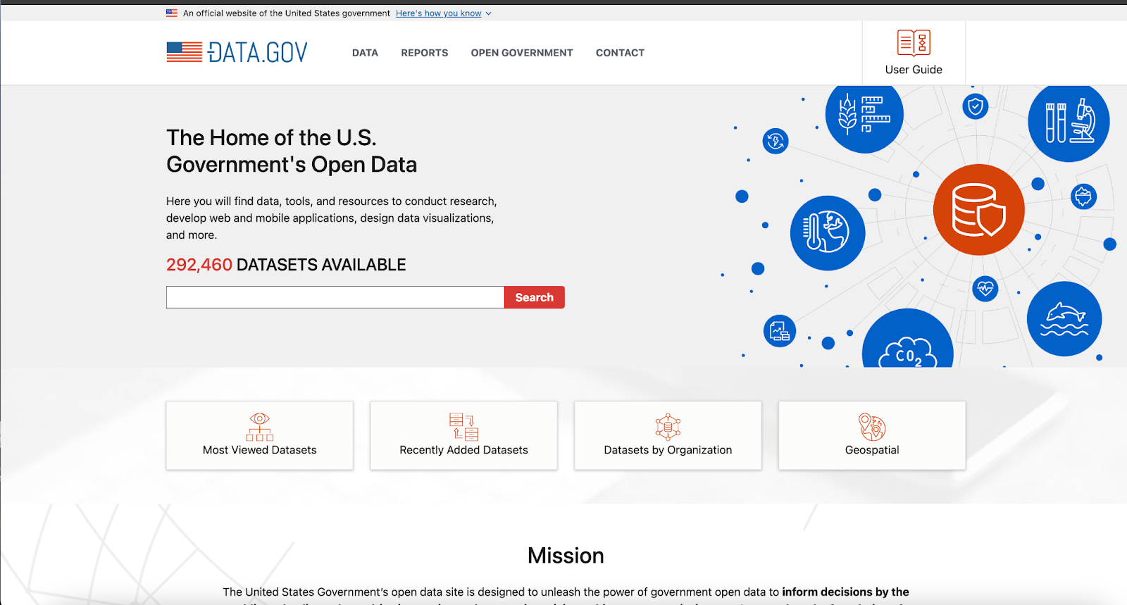
Notes:
Obama 1st day in office launched Open Data Initiative
This is a direct result
It’s *our* (citizen’s) data

Slide 42
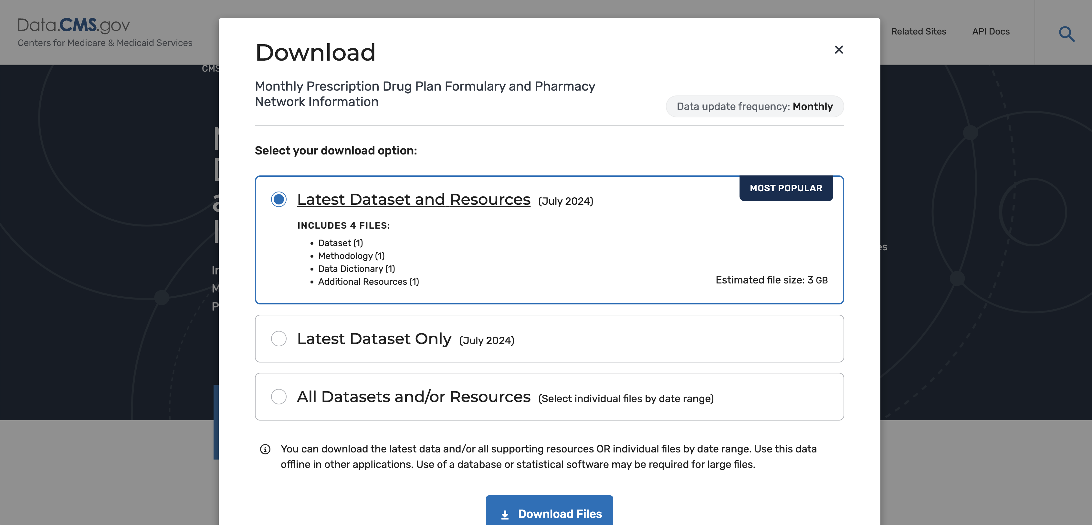
Notes:
CMS has followed the Obama directive
Pset 1 you get your hands dirty with some CMS data

Slide 43
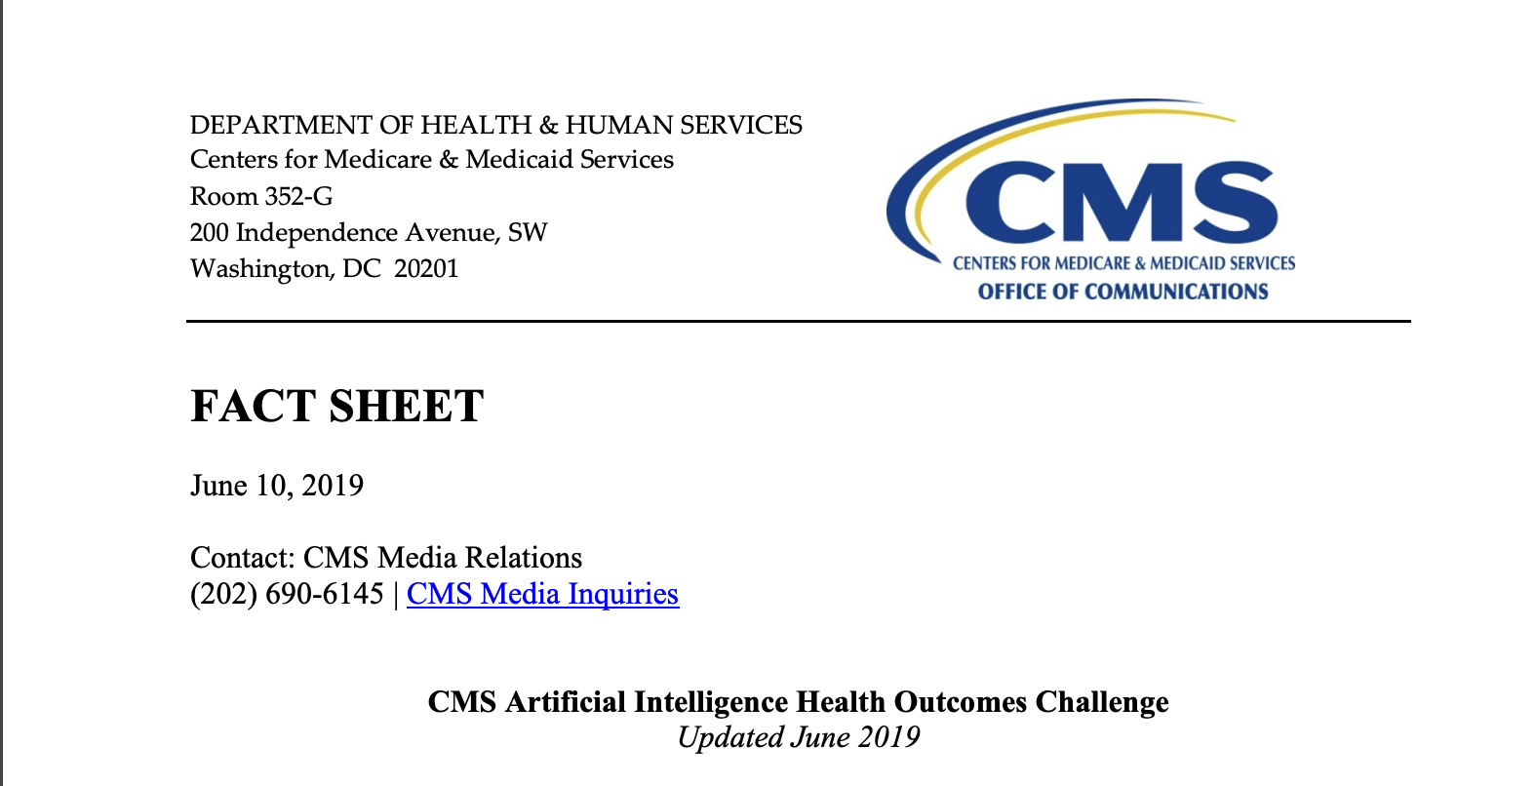
Notes:
CMS didn’t stop there –
300 applicants, 25 participants

Slide 44
Stage 1: Predict 30d adverse events: unplanned hospital admission, SNF admission, etc.
Stage 2: Also predict 12-month mortality for all Medicare beneficiaries
Data: random 5% of Medicare FFS beneficiaries (770K total) with claims (Part A,B) from 2008-11.
Prize: $1.6M total

Slide 45
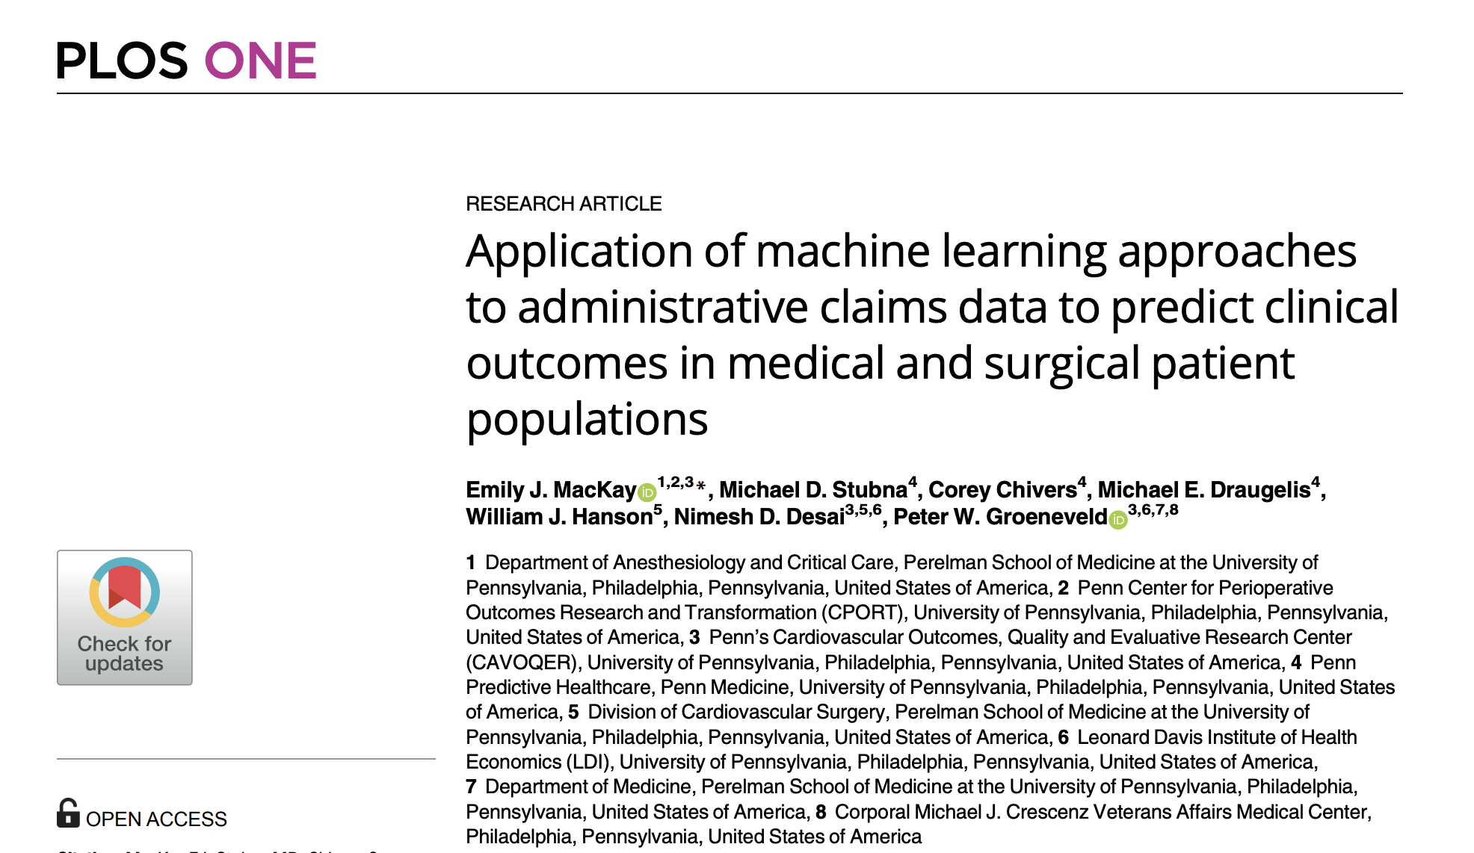
https://journals.plos.org/plosone/article?id=10.1371/journal.pone.0252585
Notes:
Here’s a paper published by one of the participating groups

Slide 46
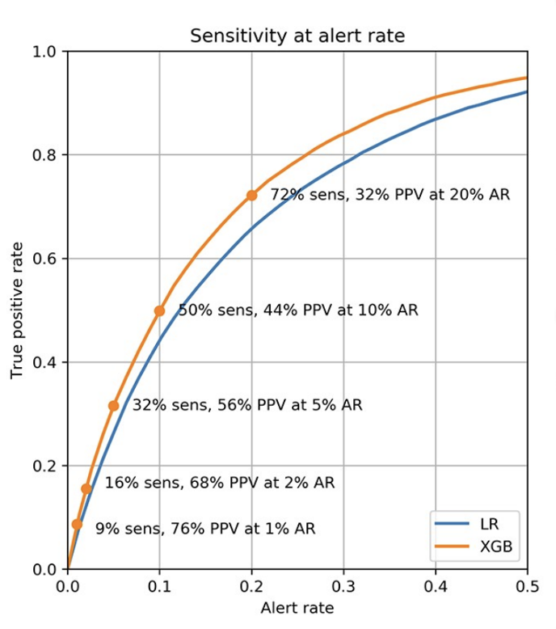
https://journals.plos.org/plosone/article?id=10.1371/journal.pone.0252585
Notes:
What is this graph saying?
1% alert rate => alerts for the top 1% highest scoring events
Sens = recall
PPV = precision = TP/(TP+FP)

Slide 47
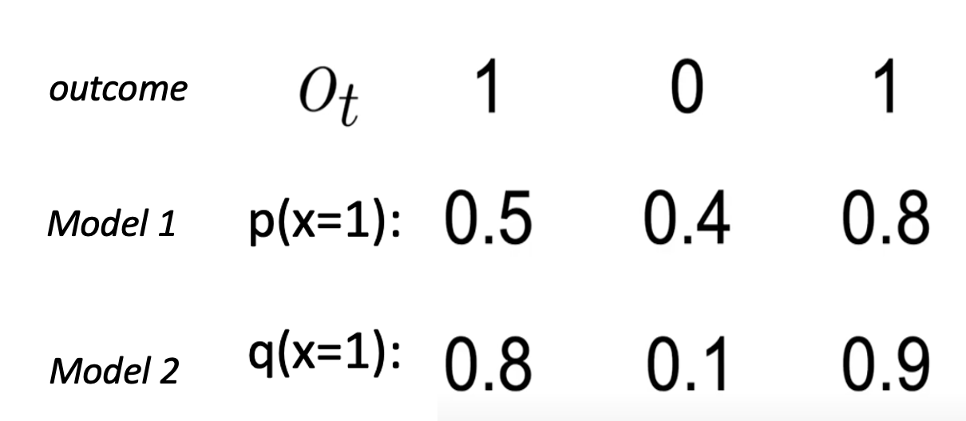
Notes:
Brier scores.
Comes up a LOT in MLH papers.
2 models here. Which is more accurate? (they’re the same).
Which is a superior model (2nd – pdf is ‘better’)
Matters when you take action based on values (e.g. risk stratification)

Slide 48
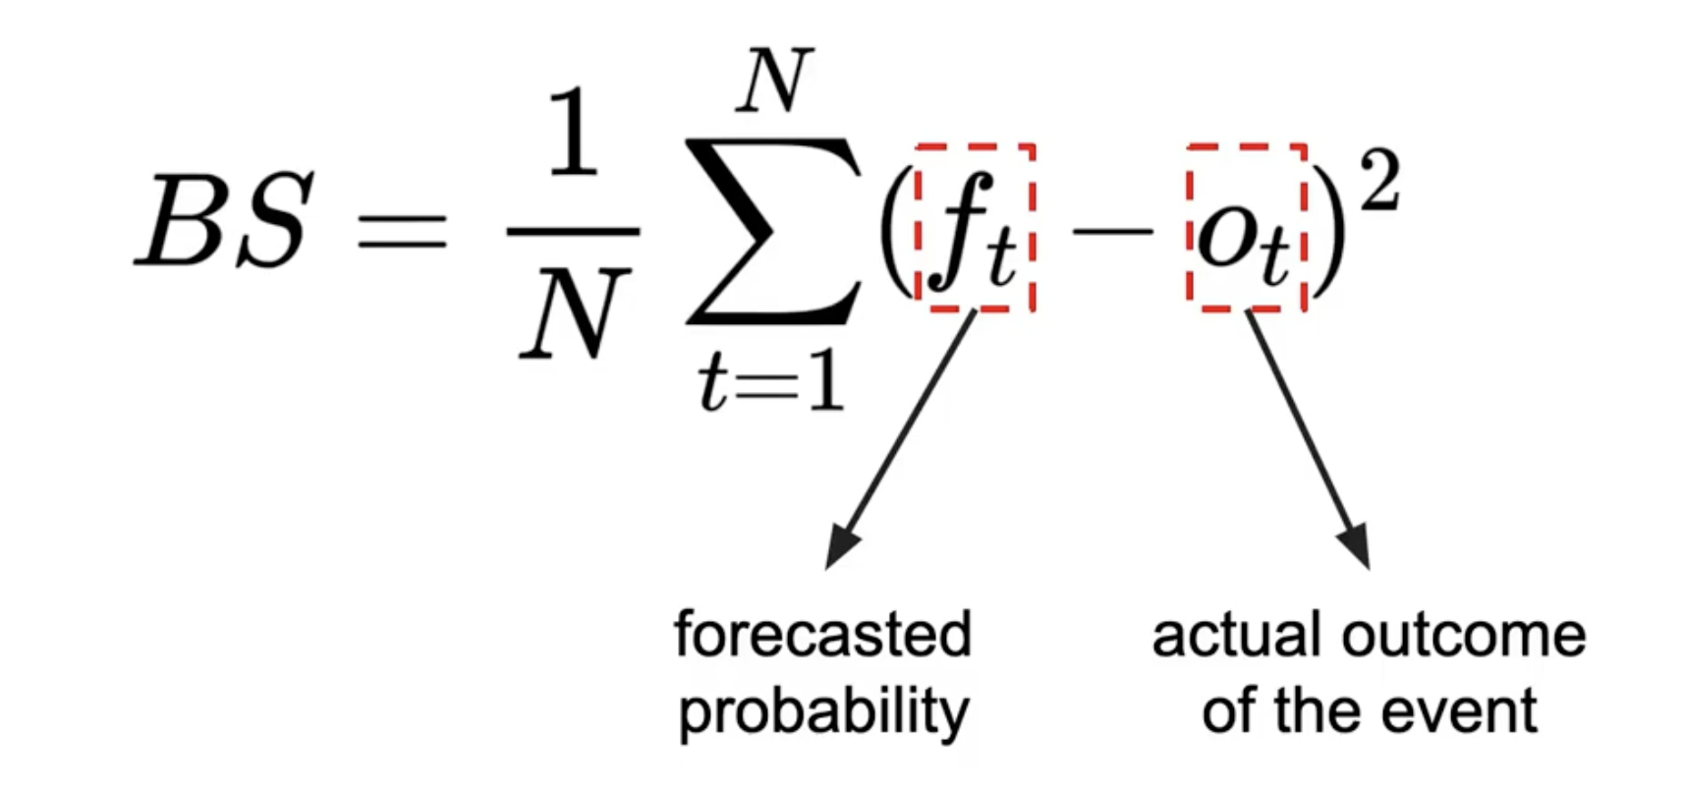
Brier Scores
https://en.wikipedia.org/wiki/Brier_score
Notes:
What’s the range of Brier scores? (0-1) Best? (0) Worst? (1)

Slide 49
Notes:
Let’s calculate Brier score for these two models
Which is the better model?

Slide 50
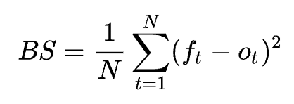
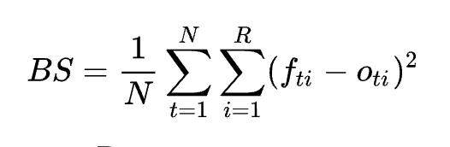
Generalized (multiclass) Brier Score
Binary:
Multiclass (R outcomes):
Notes:
Isn't Brier score just MSE?
Sortof.
Brier = MSE for binary outcomes.
But for multiclass, Brier has a different form.
Quiz: Do you get the same Brier score? (no, it’s 2x)

Slide 51
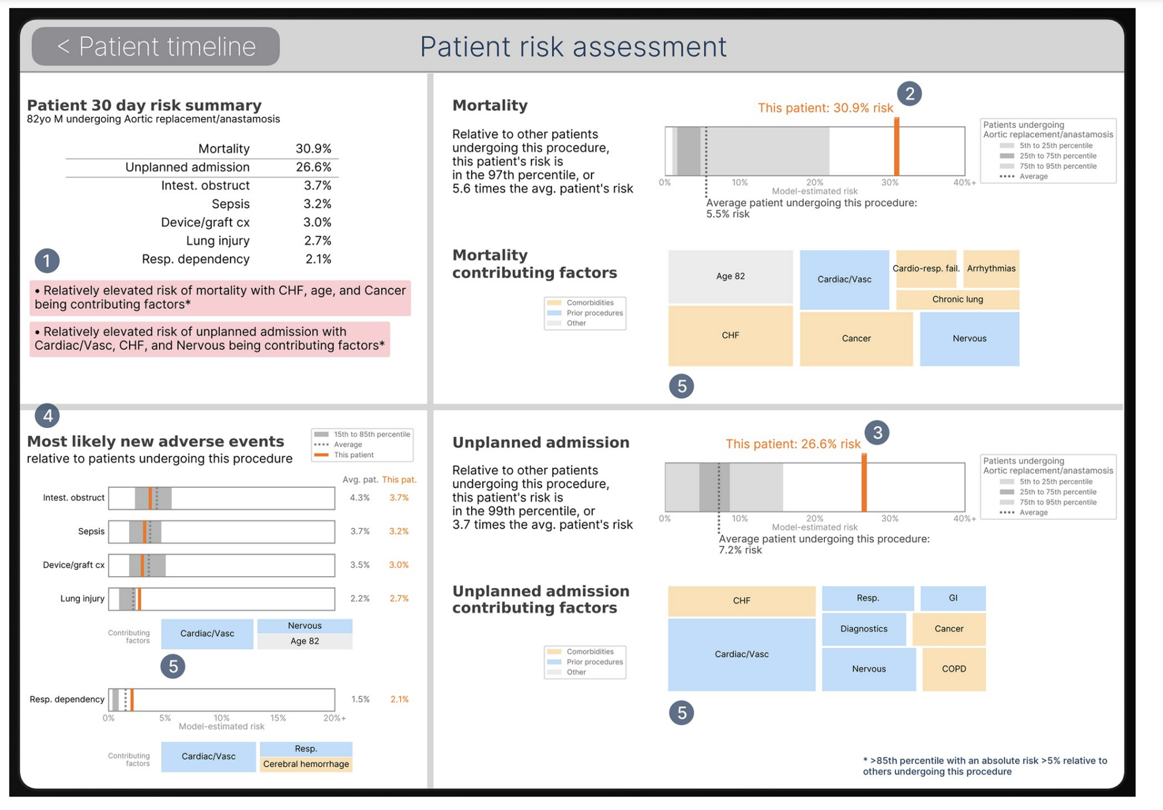
https://journals.plos.org/plosone/article?id=10.1371/journal.pone.0252585
Notes:
From same paper
Ok, you calculated these clinical outcomes for your patients. So what?
Clinician-facing tool.
What’s great about this? (explainable clear)
What’s problematic? (not actionable)

Slide 52
Today
A brief history of healthcare in U.S.
Privacy & HIPAA
De-ID
Open Data
HITECH Act
CURES Act

Slide 53
Financial Incentives
2011
2015
Up to $44K per provider
Hospitals could receive $M
Medicare reimbursement reductions from 1 to 3%
Notes:
Carrot and Stick

Slide 54
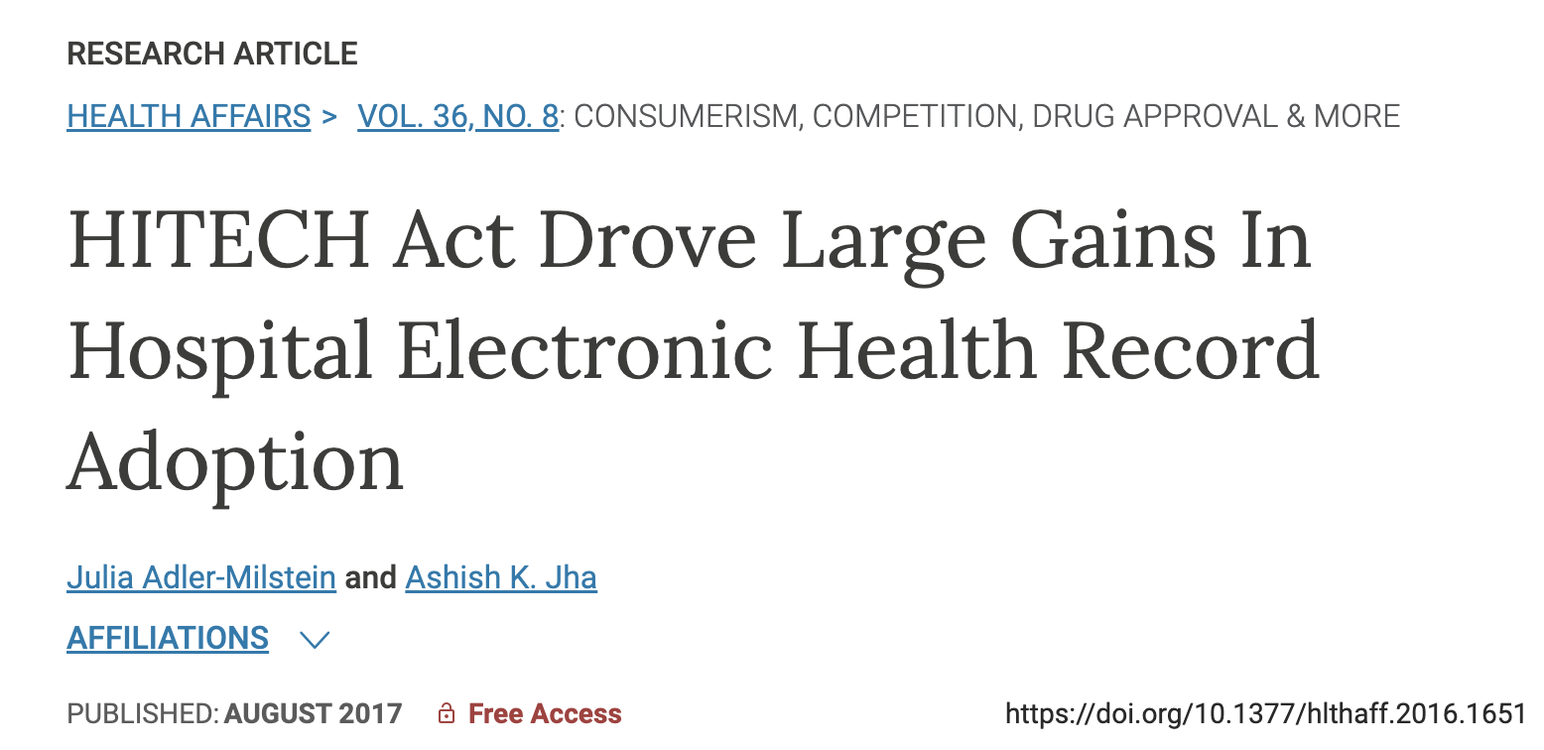
https://www.healthaffairs.org/doi/10.1377/hlthaff.2016.1651

Slide 55
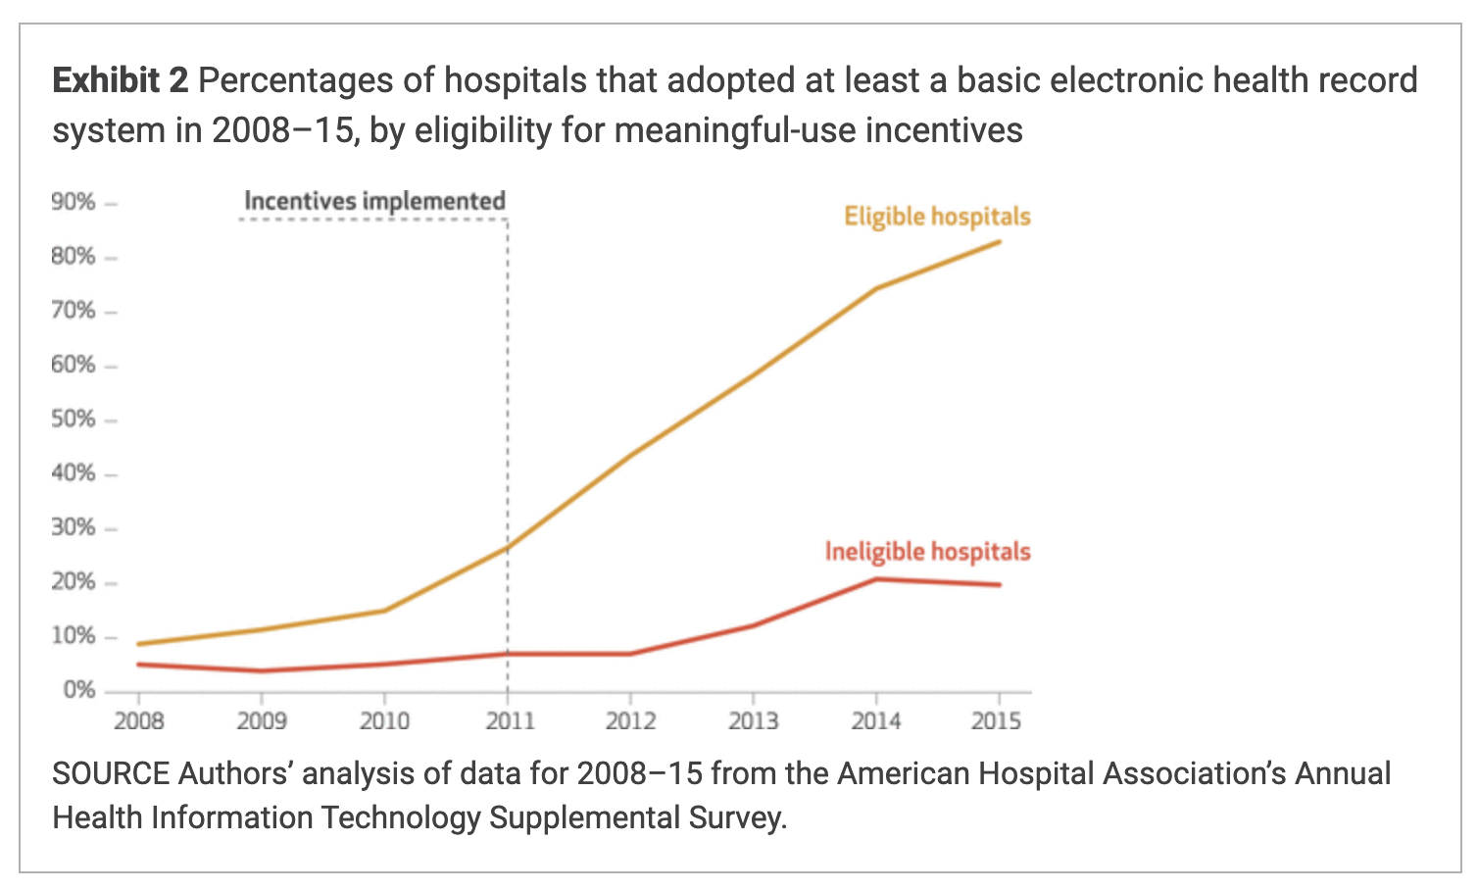
Notes:
Eligible: general and medical-surgical acute care hospitals as eligible for meaningful-use incentives
Ineligible: long-term acute care, psychiatric, and rehabilitation hospitals

Slide 56
Meaningful Use (MU)?
MU: e-prescribing, rx-rx checking, handling problem, rx, and allergy lists.
But:
Systems that are all silo’ed (no interop)
Systems that all encoded data their own way (no standardization)
Systems that were closed (“information blocking”)
Notes:
You don’t get the reward just for standing up an EHR
Needs to support ‘meaningful use’
“Meaningless use”
No INTEROPERABILITY

Slide 57
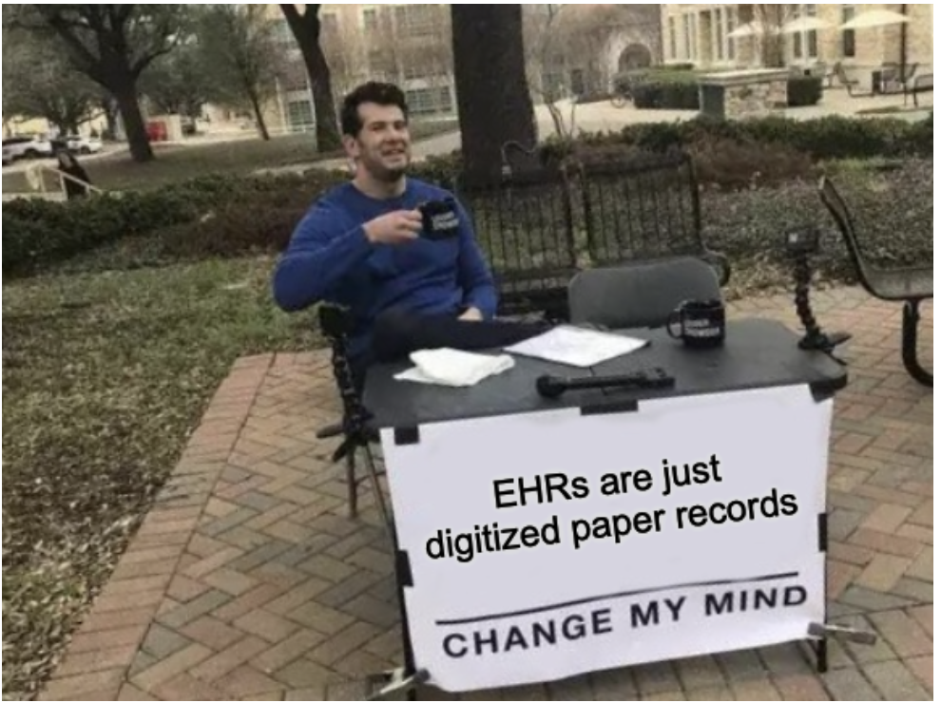

Slide 58
Today
A brief history of healthcare in U.S.
Privacy & HIPAA
De-ID
Open Data
HITECH Act
CURES Act

Slide 59
CURES ACT (2016)
EHR systems must provide APIs
These APIs must be available to providers and patients
These APIs must expose at least USCDI
Notes:
FHIR in pset 1
FHIR – Apple Health

Slide 60
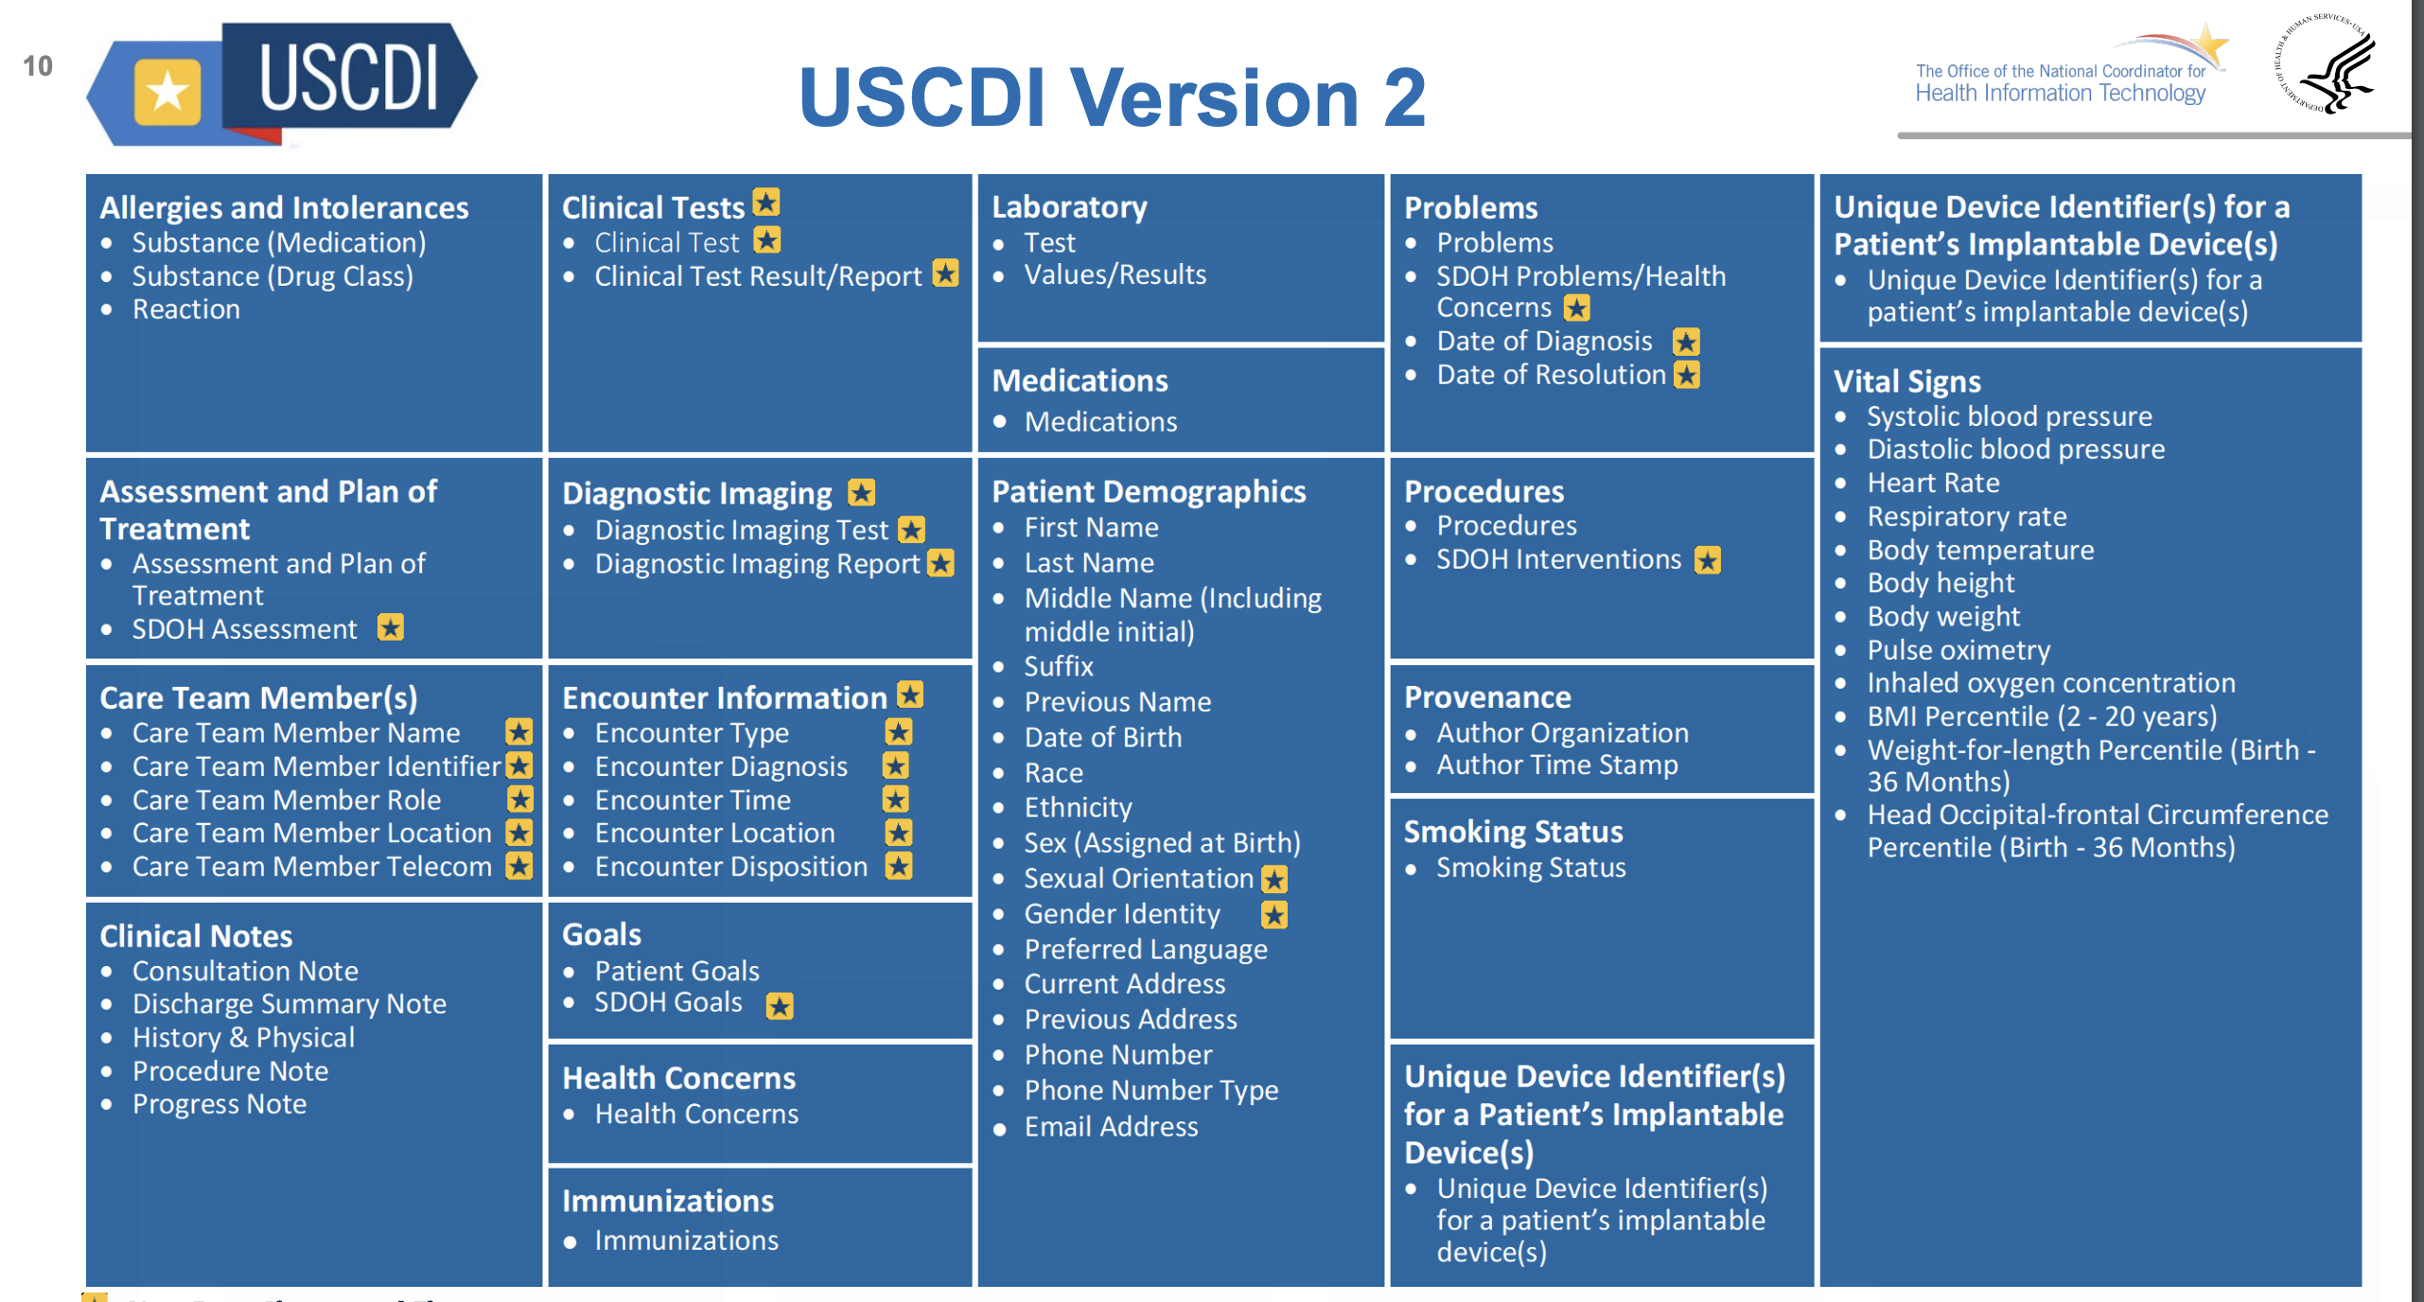
USCDI
https://www.healthit.gov/sites/default/files/2022-02/USCDI%20USCDI_Plus%20-%20Annual%20Meeting%20Slides_Final_508.pdf

Slide 61
EOL

